Slide 1
IP Address
&
DHCP
Computer Networking Laboratory
Mr. Amin Mojaveri
Hanie Vatani
Parsa Omidi

Slide 2
1. IP Versions
2. IP Addressing
3. DHCP
1.1 IPv4 Datagram format 3
1.2 Question? 5
1.3 Note 6
1.4 IPv6 7
1.5 IPv6 Datagram format 8
1.6 IPv6 vs IPv4 9
2.1 Router’s Interfaces 10
2.2 IPv4 Structure 11
2.3 Subnet’s IP 12
2.4 CIDR 15
3.1 DHCP 16
3.2 Lease & DORA 17
3.3 DORA (Continuing ) 18

Slide 3
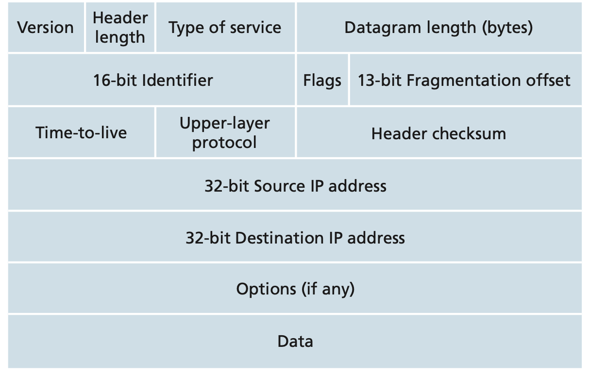
1.1 IPv4 Datagram format:
The key fields in the IPv4 datagram:
total length of the IP datagram (header plus data), measured in bytes; not more than 1500 bytes.
4 bits that determine where in the IP datagram, the payload begins.
TOS is the type of service bits were included in the IPv4 header.
32 bits
4 bits number that specify the IP version of datagram.
these three fields have to do IP fragmentation. IPv6 doesn't allow this fragmentation.
TTL field is included to ensure that datagrams don't circulate forever.
The value of this field indicates the specific transport-layer protocol to which the data portion of this IP datagram should
be passed.

Slide 4
1.1 IPv4 Datagram format:
The key fields in the IPv4 datagram:
The options fields allow an IP header to be extended. IP options were not included in the IPv6 header.
Internet checksum aids a router in detecting bit errors in a received IP datagram.
32 bits
payload is the last and most important field; contains the transport-layer segment (TCP/UDP).
Often the source host determines the destination address via a DNS lookup.

Slide 5
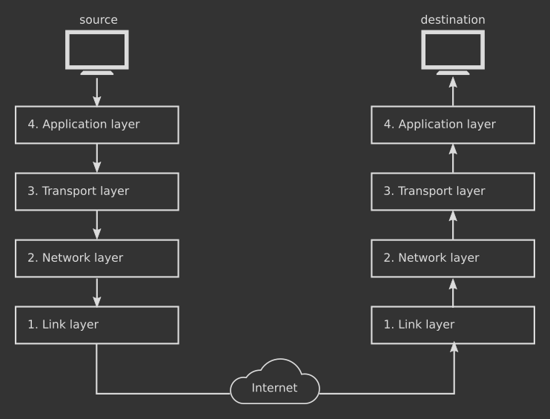
1.2 A Question?
A question often asked at this point is, why does TCP/IP perform error checking at both the transport and network layers?
There are several reasons for this repetition. First, note that only the IP header is checksummed at the IP layer, while the TCP/ UDP checksum is computed over the entire TCP/UDP segment. Second, TCP/ UDP and IP do not necessarily both have to belong to the same protocol stack. TCP can, in principle, run over a different network-layer protocol (for example, ATM) and IP can carry data that will not be passed to TCP/UDP.

Slide 6
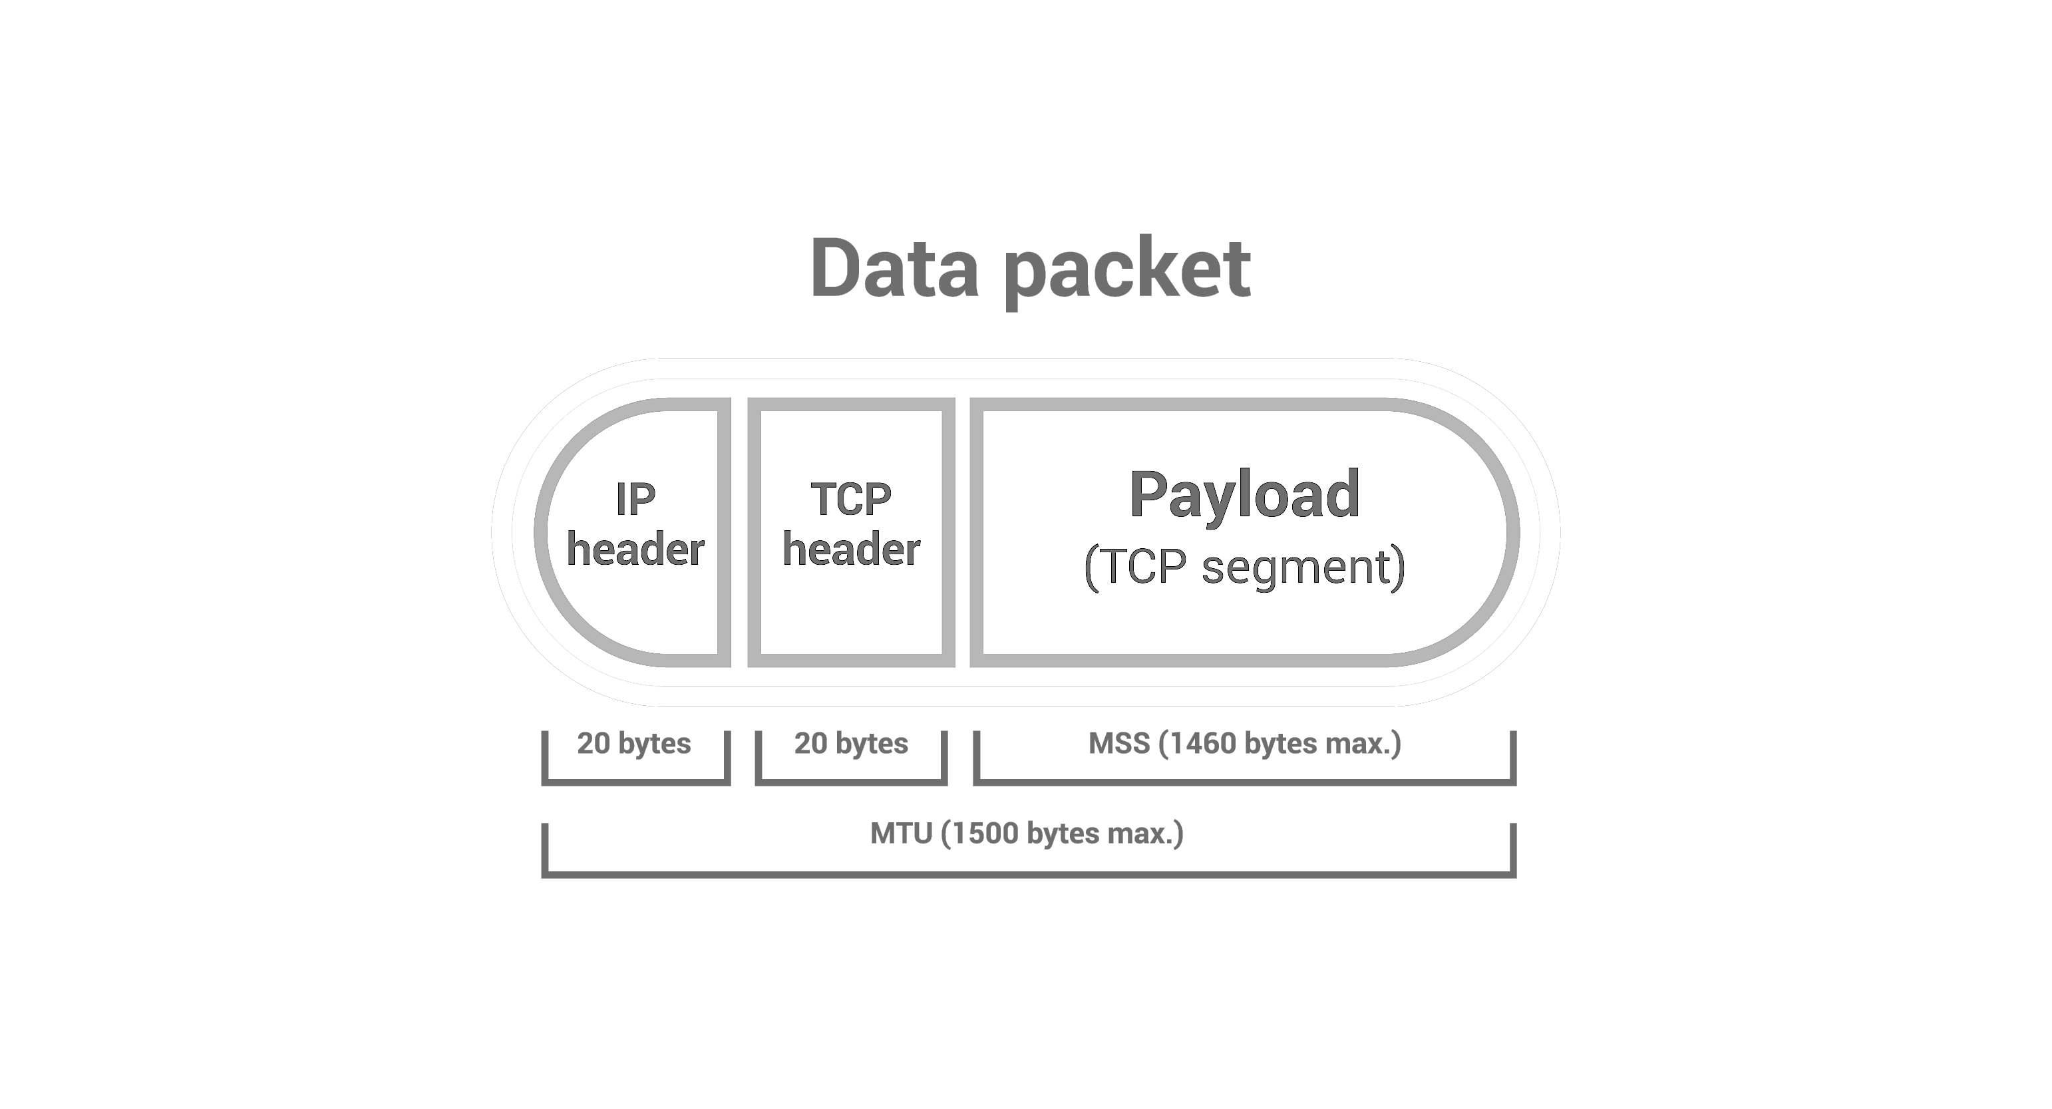
1.3 Note:
An IP datagram has a total of 20 bytes of header (assuming no options). If the datagram carries a TCP segment, then each datagram carries a total of 40 bytes of header (20 bytes of IP header plus 20 bytes of TCP header) along with the application-layer message.

Slide 7
1.4 IPv6:
The most important changes introduced in IPv6 are evident in the datagram format:
Expanded addressing capabilities.
A streamlined 40-byte header.
Flow labeling.
IPv6 has introduced a new type of address, called an anycast address, that allows a datagram to be delivered to any one of a group of hosts.
2001:0db8:85a3:0000:0000:8a2e:0370:7334
Site Prefix
Subnet ID
Interface ID

Slide 8
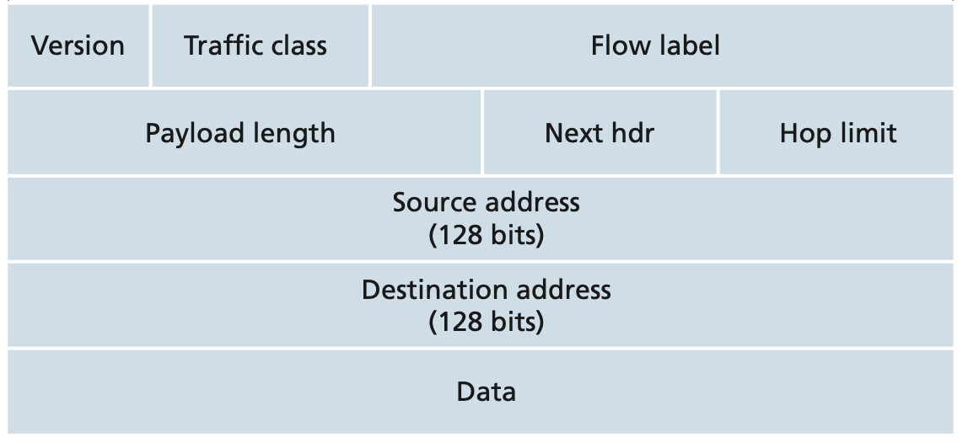
1.5 IPv6 Datagram format:
The key fields in the IPv6 datagram:
20-bit field is used to identify a flow of datagrams.
The 8-bit that can be used to give priority to certain datagrams
This 4-bit field identifies the IP version number.
carries a value of 6.
This field identifies the protocol to which the contents of this datagram will be delivered.
32 bits
This field are decremented by one by each router that forwards the datagram.
IPv6 has 128-bit address.
payload portion of the IPv6 datagram.

Slide 9
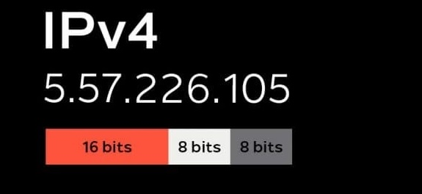
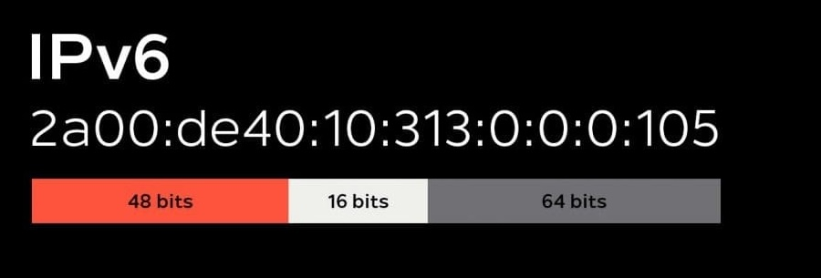
1.6 IPv6 vs IPv4 :
Comparing the IPv6 datagram format with the IPv4 datagram format:
Fragmentation/Reassembly.
Header checksum.
Options.
IPv4
IPv6

Slide 10
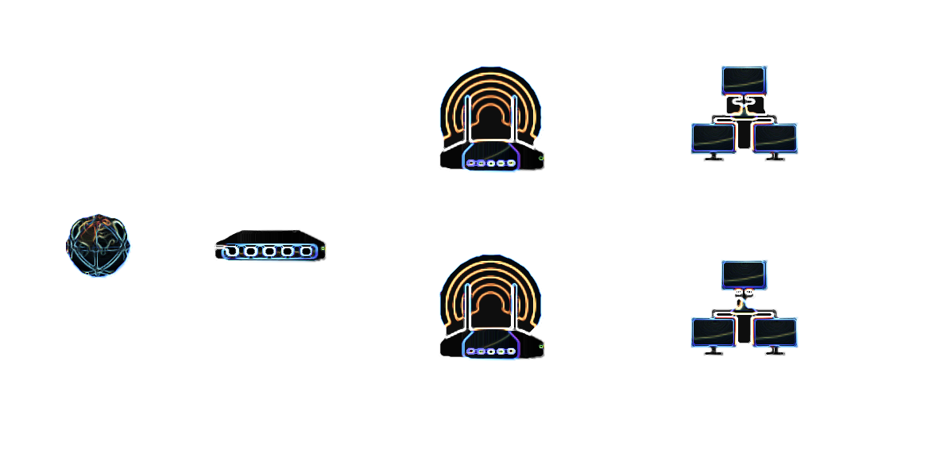
2.1 Router’s Interfaces:
How hosts and routers are connected into the Internet?
The boundary between the host and the physical link is called an interface. Because a router’s job is to receive a datagram on one link and forward the datagram on some other link, a router necessarily has two or more links to which it is connected.
The boundary between the router and any one of its links is also called an interface. A router thus has multiple interfaces, one for each of its links. IP requires each host and router interface to have its own IP address.
Interface
Wireless Router/AP
Guest Network
Internet
Router
Wireless Router/AP
Home Network

Slide 11
2.2 IPv4 Structure:
Each IP address is 32 bits long (equivalently, 4 bytes), and there are thus a total of 2³² (or approximately 4 billion) possible IP addresses.
These addresses are typically written in so-called dotted-decimal notation.
Example:
consider the IP address 193.32.216.9;
The 193 is the decimal equivalent of the first 8 bits of the address;
The 32 is the decimal equivalent of the second 8 bits of the address, and so on.
Thus, the address 193.32.216.9 in binary notation is:
11000001 00100000 11011000 00001001

Slide 12
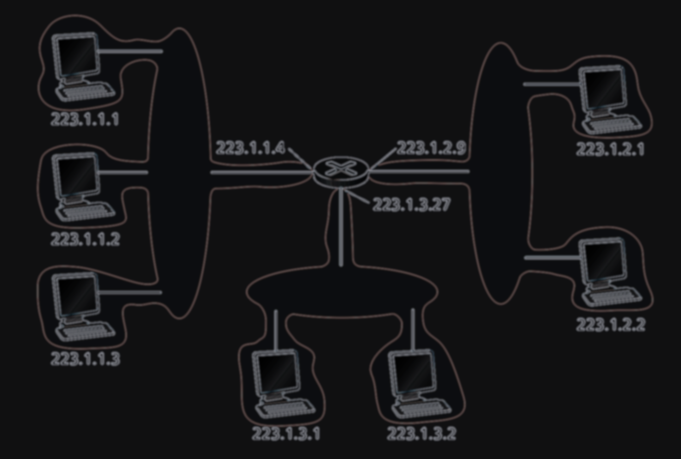
2.3 Subnet’s IP:
interfaces
Subnet
Subnet
Subnet

Slide 13
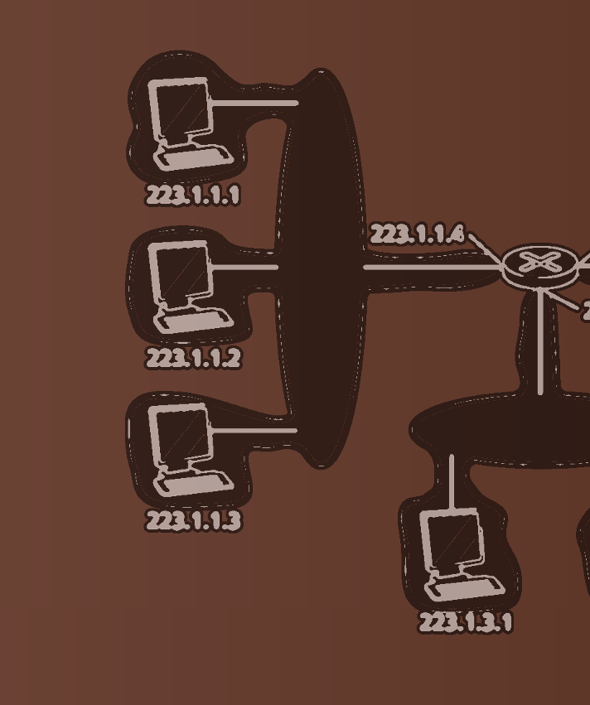
2.3 Subnet’s IP:
Subnet Mask:
the leftmost 24 bits of the 32-bit
223.1.1.XXX/24

Slide 14
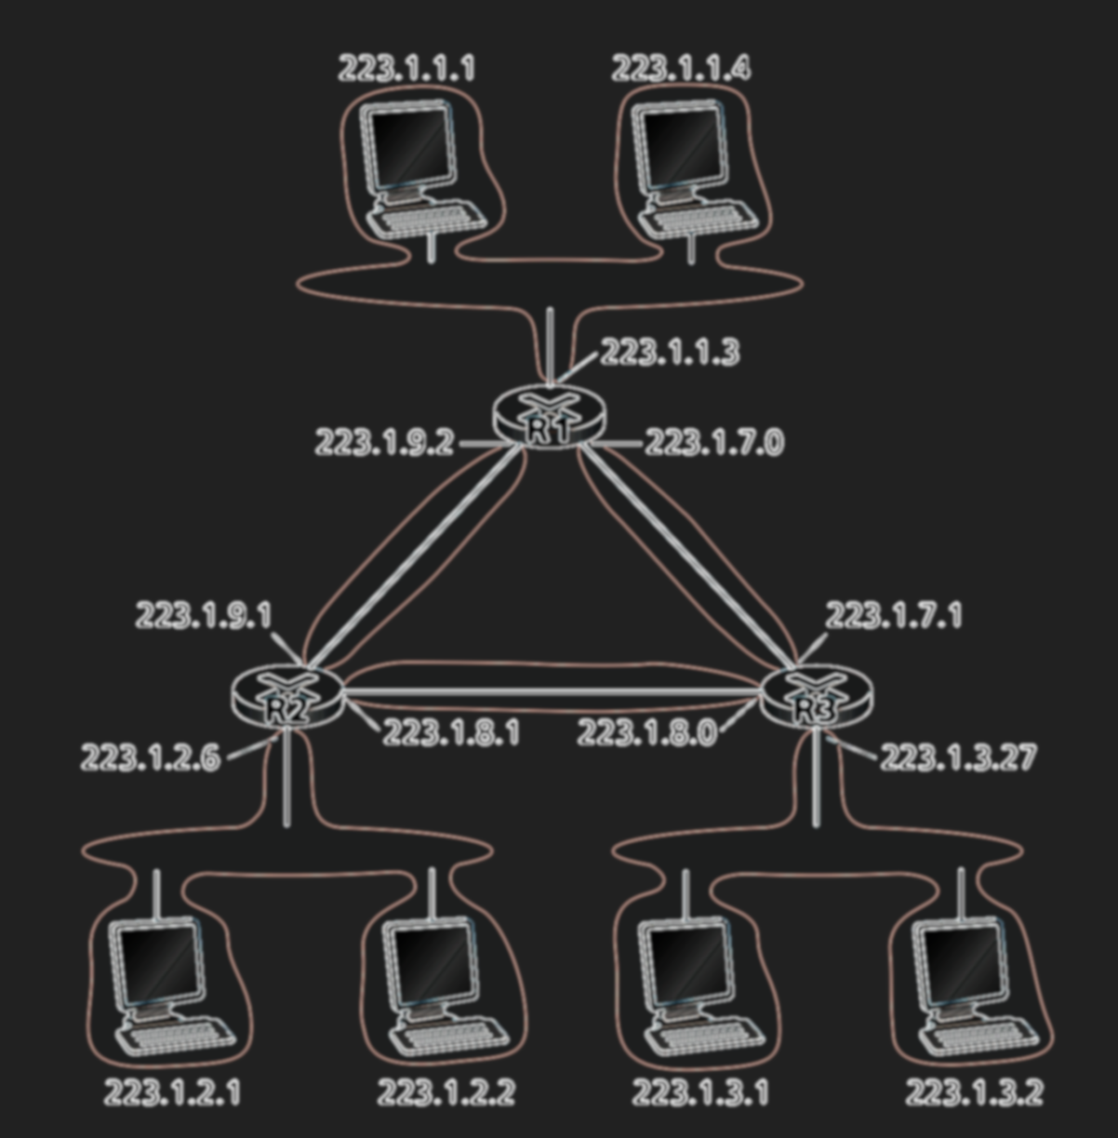
2.3 Subnet’s IP:
To determine the subnets, detach each interface from its host or router, creating islands of isolated networks, with interfaces terminating the end points of the isolated networks. Each of these isolated networks is called a subnet.
223.1.9.0/24
Subnet
223.1.9.0/24
Subnet
223.1.9.0/24
Subnet

Slide 15
2.4 CIDR:
The Internet’s address assignment strategy is known as Classless Interdomain Routing.
CIDR generalizes the notion of subnet addressing. As with subnet addressing, the 32-bit IP address is divided into two parts.
x bits for outside of the organization’s network.
32-x bits for within the organization’s network.
This considerably reduces the size of the forwarding table in these routers.
Classful Addressing:
Network Prefix
8-bit A
16-bit subnet addresses are: class B
24-bit C
a.b.c.d/x

Slide 16
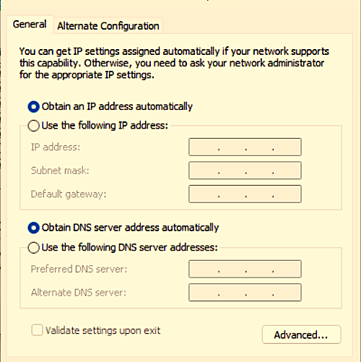
3.1 DHCP:
DHCP (Dynamic Host Configuration Protocol):
There are 2 ways of assigning IP:
Manually.
By DHCP.

Slide 17
3.2 Lease & DORA:
How much time can a client hold an IP address?
The DHCP Lease time is the mechanism that allows DHCP servers to reclaim IP addresses, preventing a host from permanently retaining an IP address.
DORA:
Discover | Client -> Server | Broadcast
Offer | Server -> Client | Broadcast/Unicast
Request | Client -> Server | Broadcast
ACK | Server -> Client | Broadcast/Unicast

Slide 18
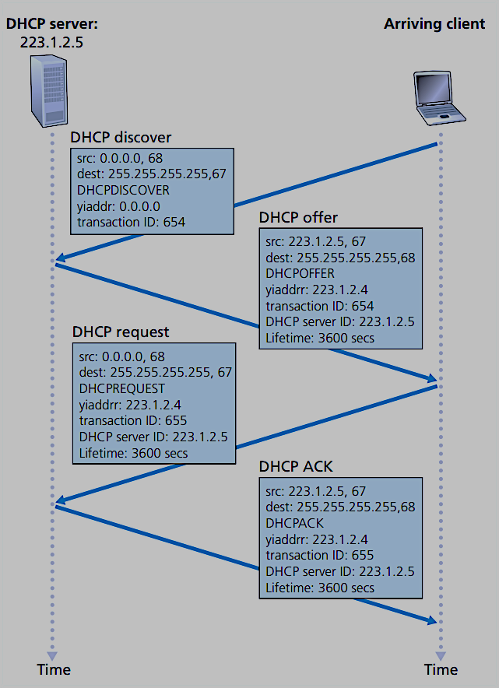
3.3 DORA (Continuing):

Slide 19
The End.

